Slide 1

Student Record Management System using Microsoft Azure
Sundram Singh
Cloud Computing
[Lovely Professional University]

Slide 2


Introduction
A Student Record Management System (SRMS) is a digital platform that stores, manages, and retrieves student information efficiently. Cloud computing revolutionises how educational institutions handle data by providing scalable, secure, and accessible solutions.
Scalability
Handle growing student databases effortlessly with cloud infrastructure
Security
Protect sensitive student data with enterprise-grade security measures
Accessibility
Access records from anywhere, anytime with internet connectivity
Why Azure
Microsoft Azure offers robust tools, seamless integration, and educational benefits

Slide 3
Project Objectives
01
02
Develop Web-Based Registration System
Secure Student Records Storage
Implement encrypted database storage for protecting sensitive student information
Create an intuitive interface for student registration accessible through any web browser
03
04
Azure App Service Deployment
Azure SQL Database Integration
Deploy the application on Microsoft Azure's reliable cloud hosting platform
Connect to a managed SQL database for efficient data storage and retrieval
05
06
Public and Private Interfaces
Real-World Cloud Skills
Build a public user form for data submission and a private admin dashboard for record management
Gain practical experience with cloud deployment, database management, and full-stack development

Slide 4
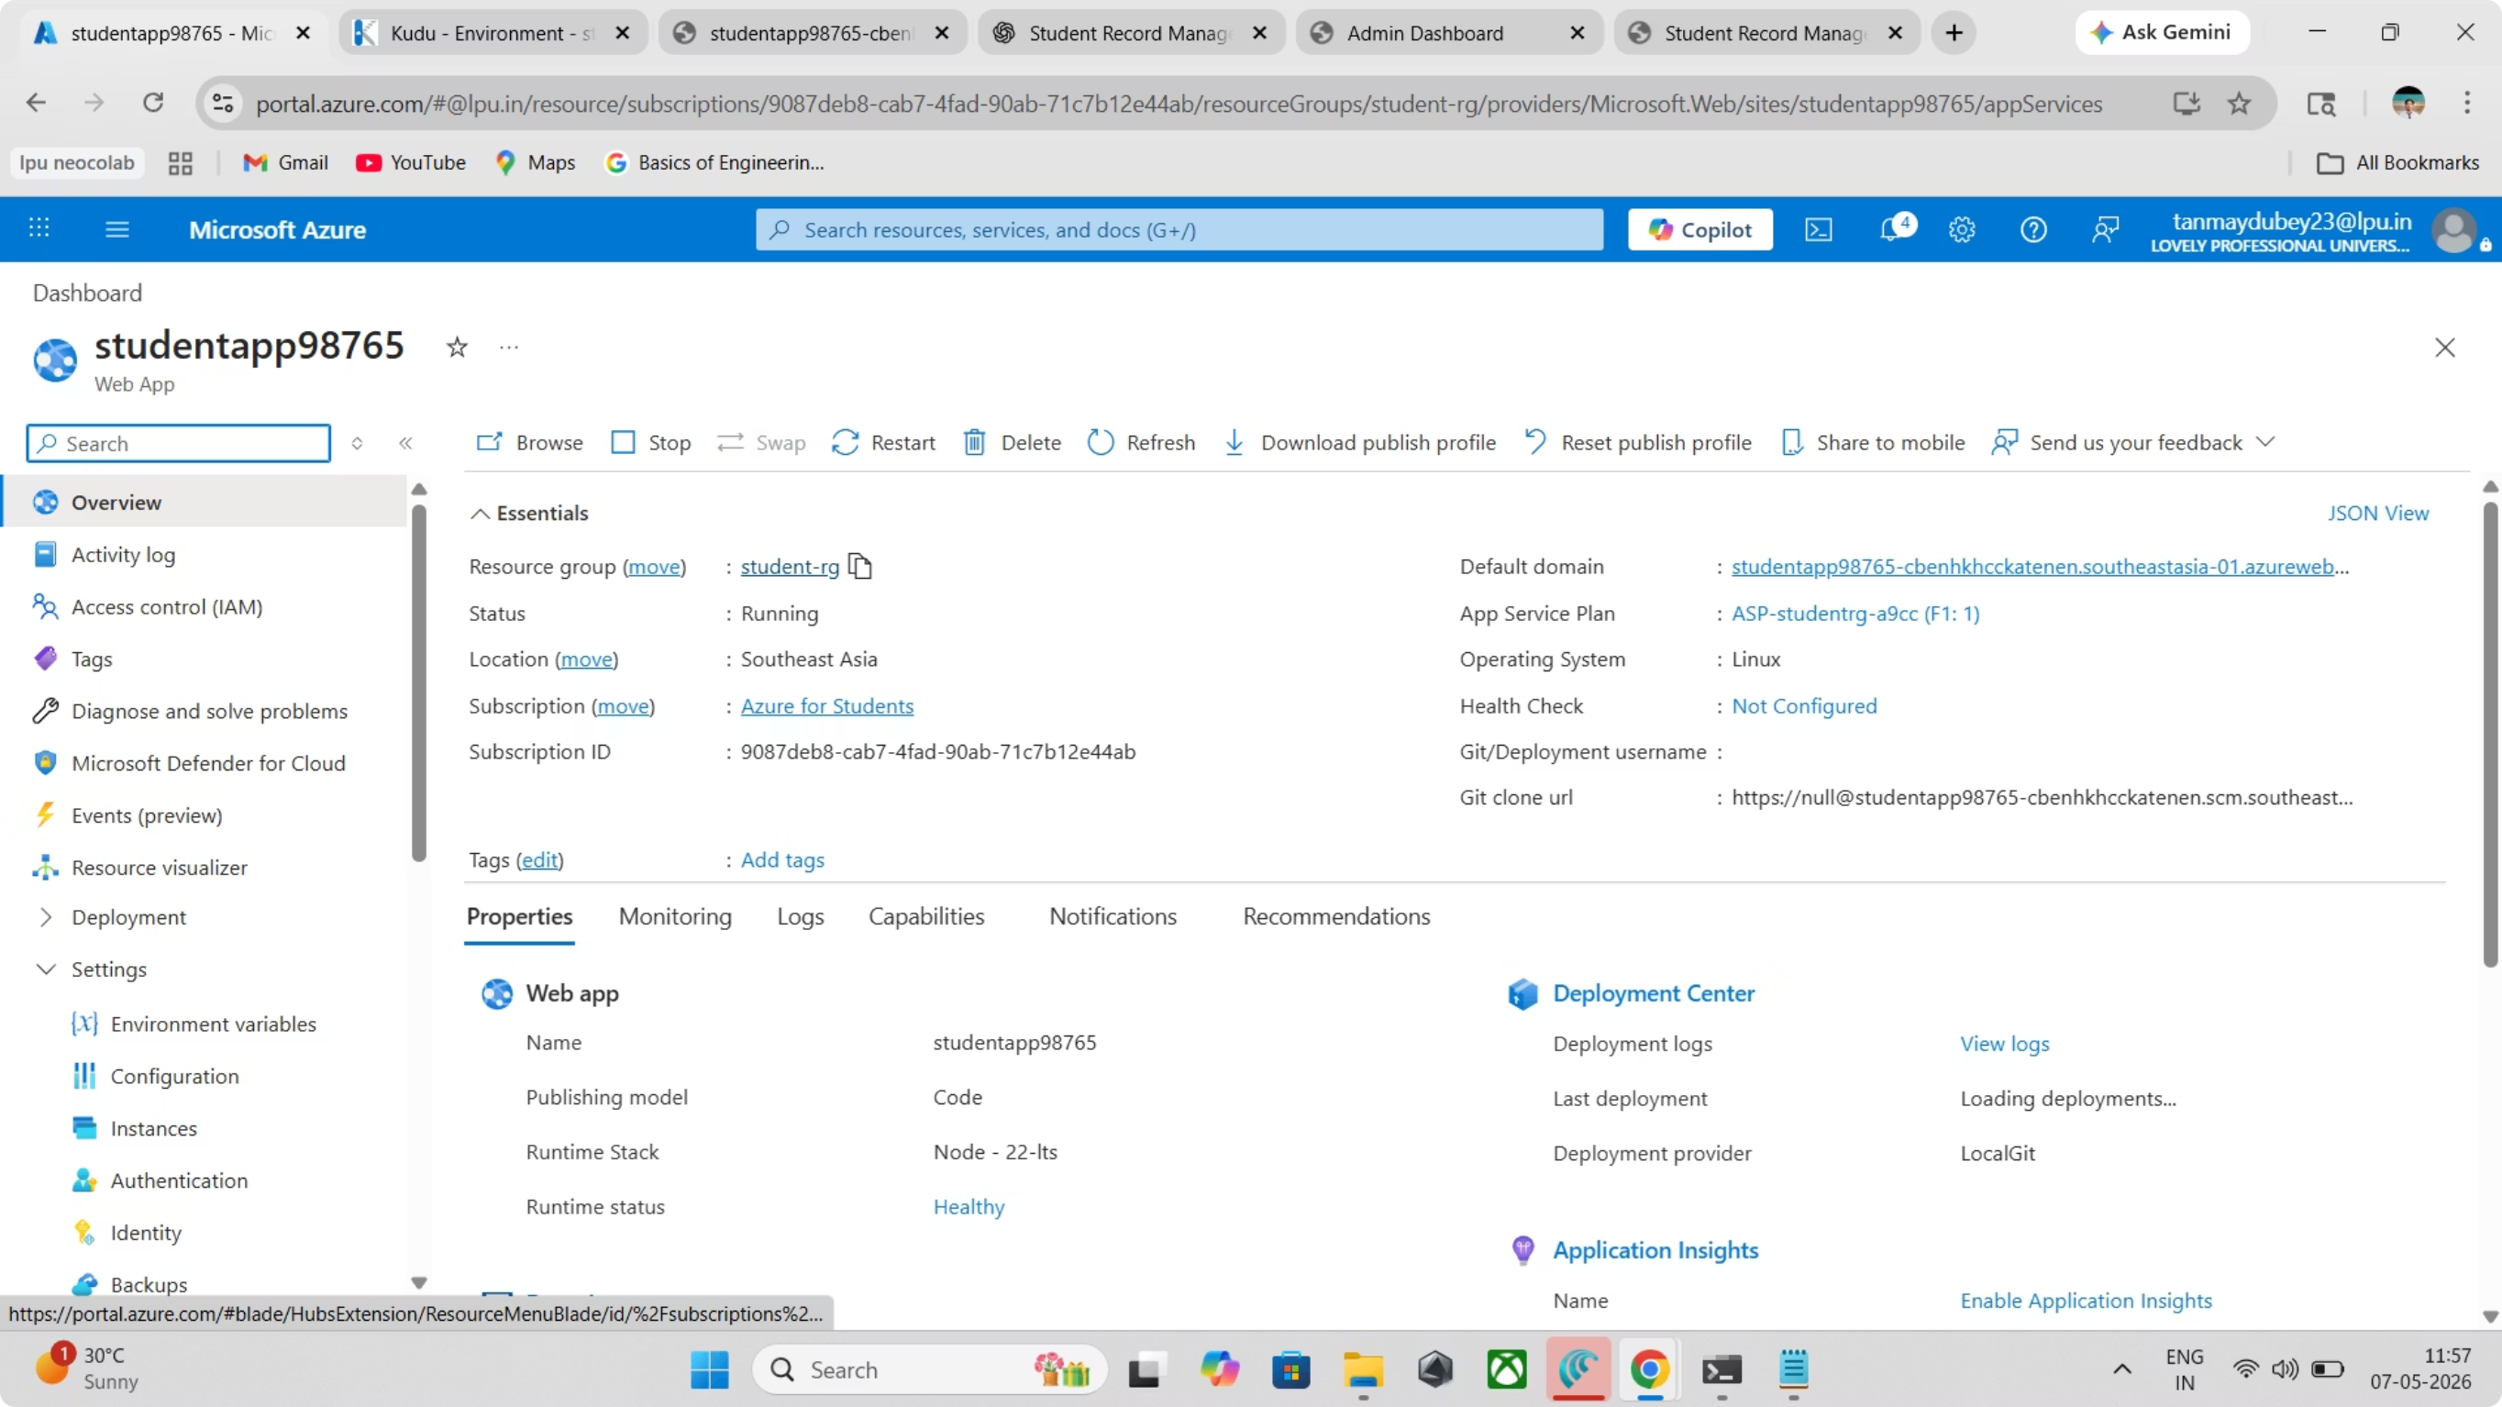

Slide 5
Technology Stack
This project leverages modern web development technologies combined with Microsoft Azure's cloud platform to create a robust, scalable solution.
Component
Technology
Frontend
HTML, CSS, JavaScript
Backend
Node.js, Express.js
Database
Azure SQL Database
Cloud Platform
Microsoft Azure
Hosting
Azure App Service
Version Control
GitHub

Slide 6
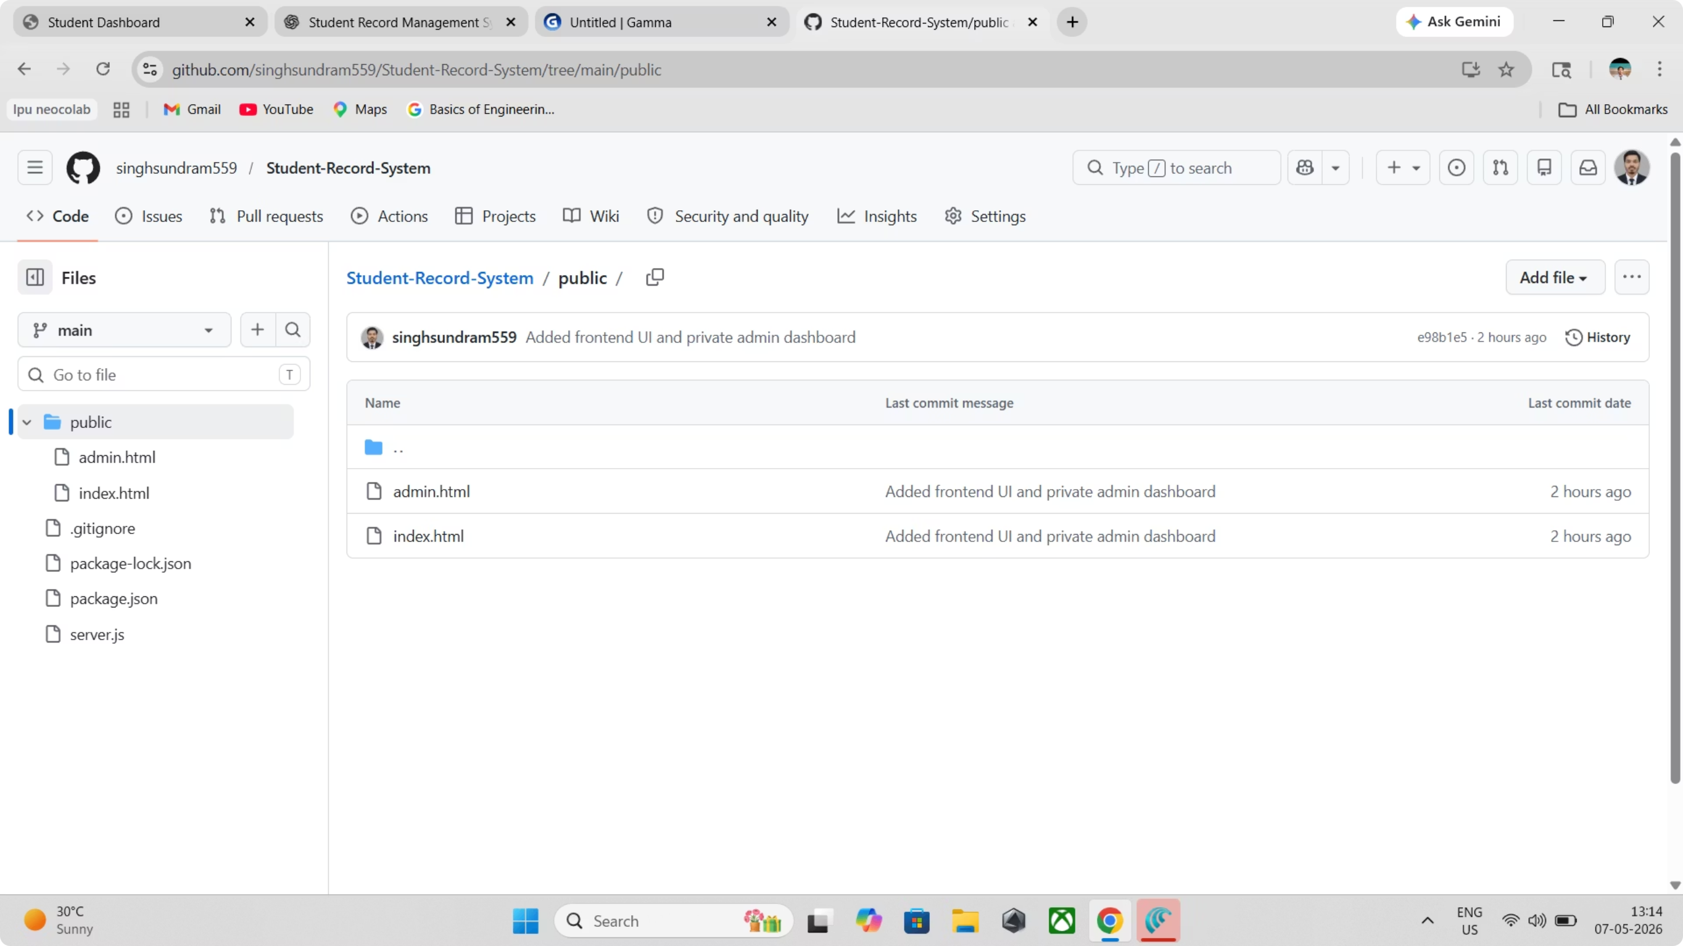

Slide 7

System Architecture
The system follows a three-tier architecture pattern, separating concerns between user interface, application logic, and data storage for maintainability and security.
Private Admin Dashboard
Public User Form
Restricted admin interface
Student-facing submission page
Three-tier Architecture
Azure SQL Database
Node.js Express Backend
Secure persistent storage
Application logic and APIs
Public Layer
Backend Layer
Students submit their information through a simple, accessible web form
Node.js handles request processing and data validation

Slide 8
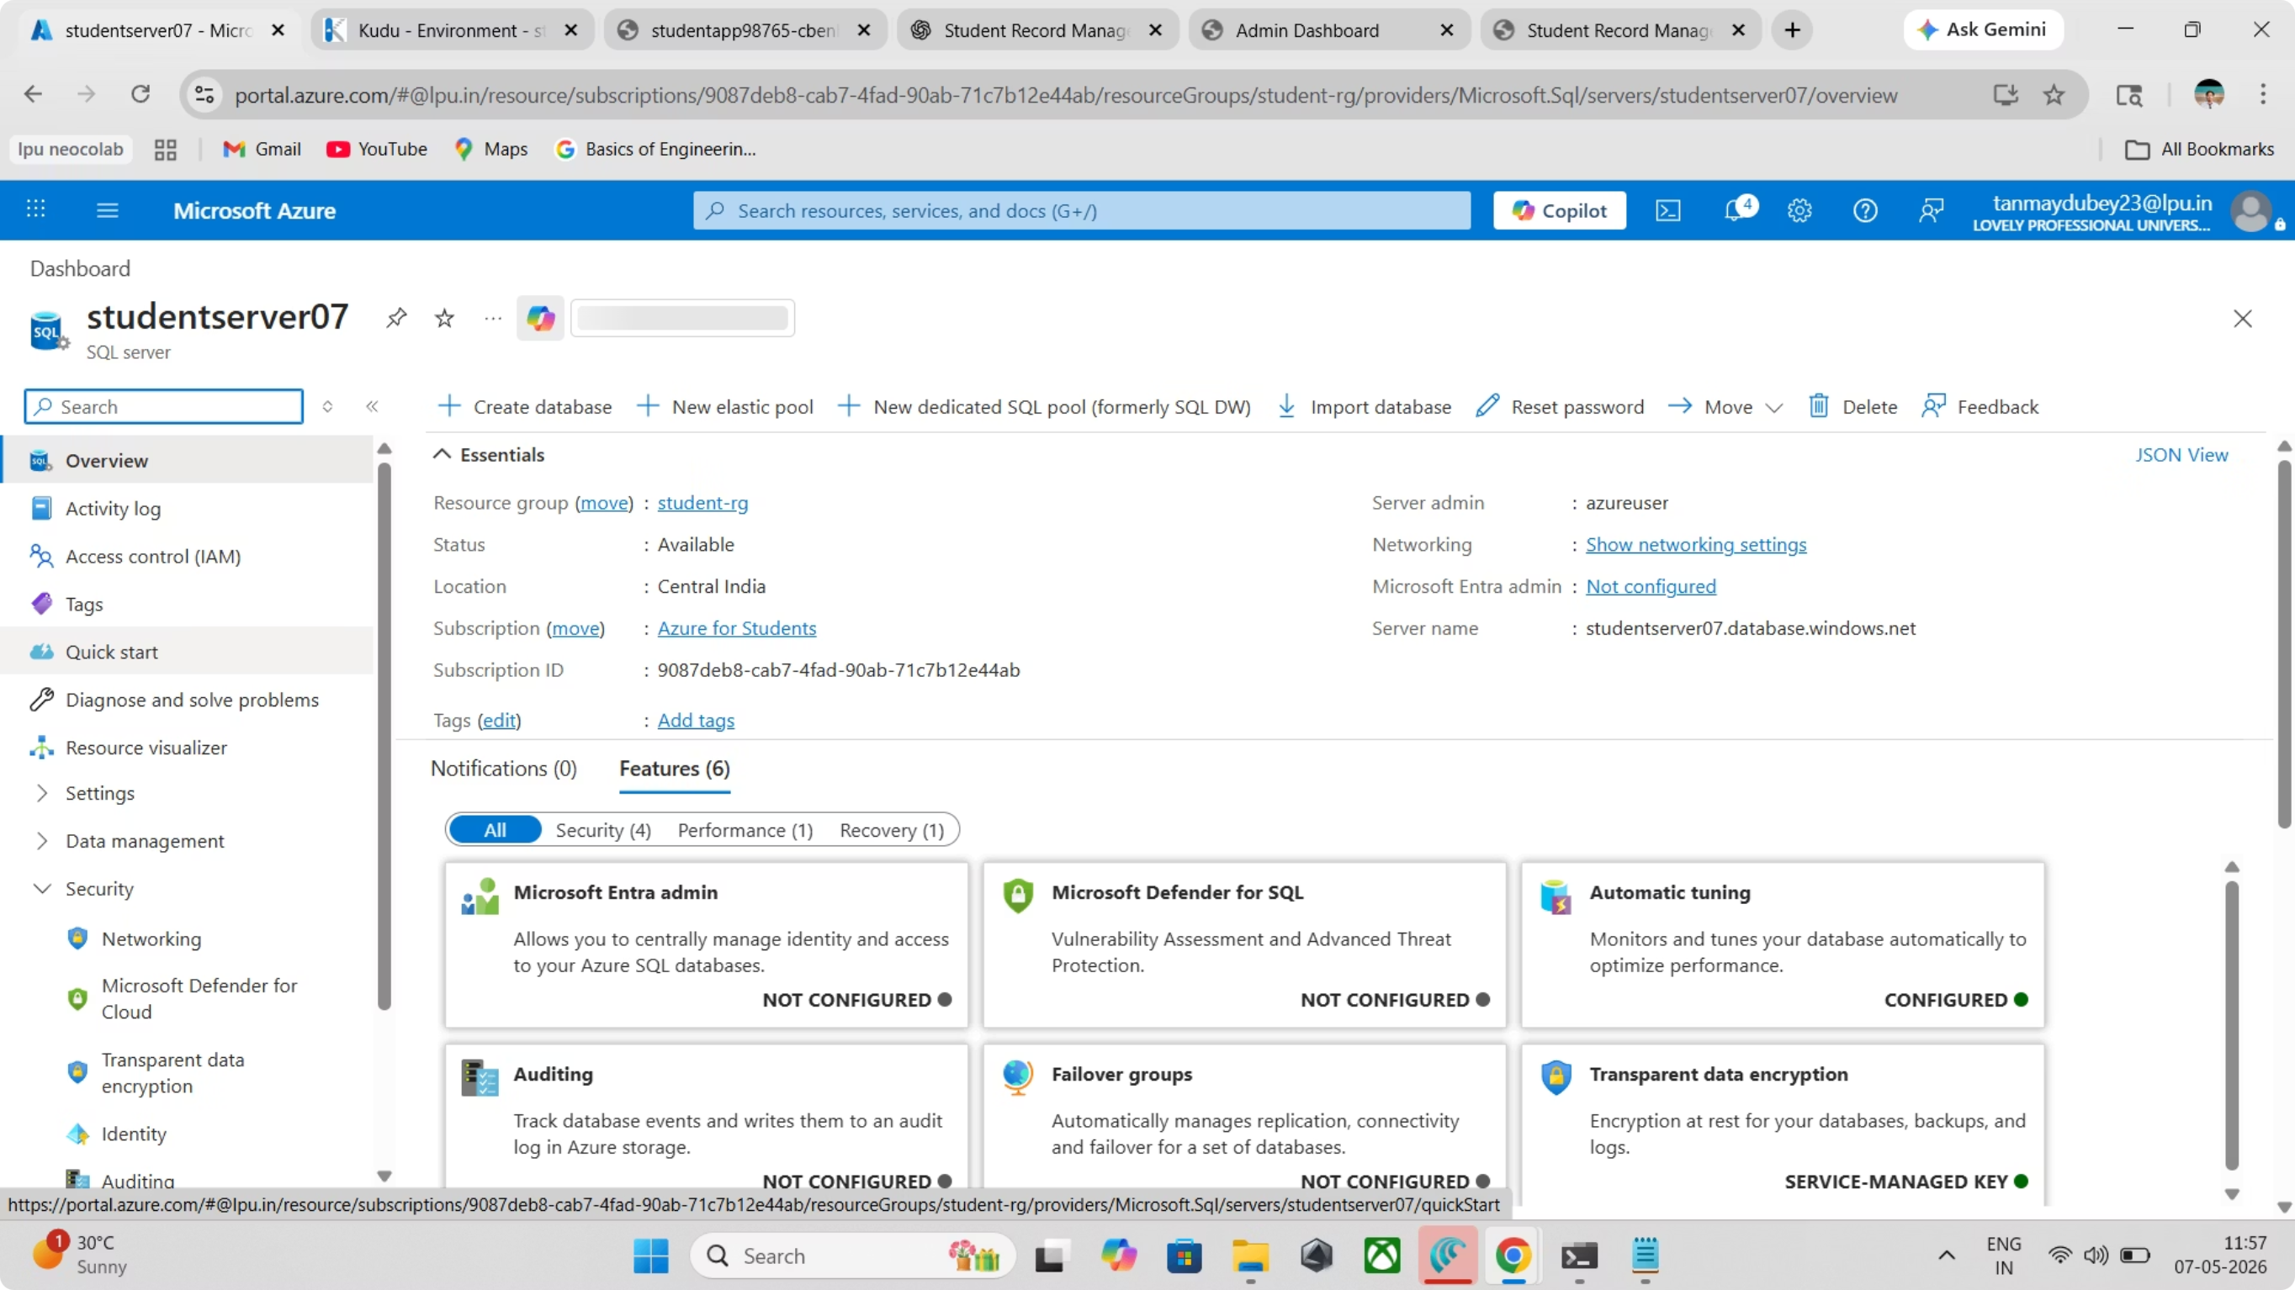

Slide 9

Database Design
Azure SQL Database Structure
The database uses a simple table structure to store essential student information with proper indexing for fast retrieval.
CREATE TABLE Students (
id INT PRIMARY KEY,
name VARCHAR(100),
age INT,
course VARCHAR(50)
);
Security Configuration
Firewall rules restrict access to authorised IP addresses
Encrypted connections using SSL/TLS protocols
Role-based access control for admin dashboard

Slide 10
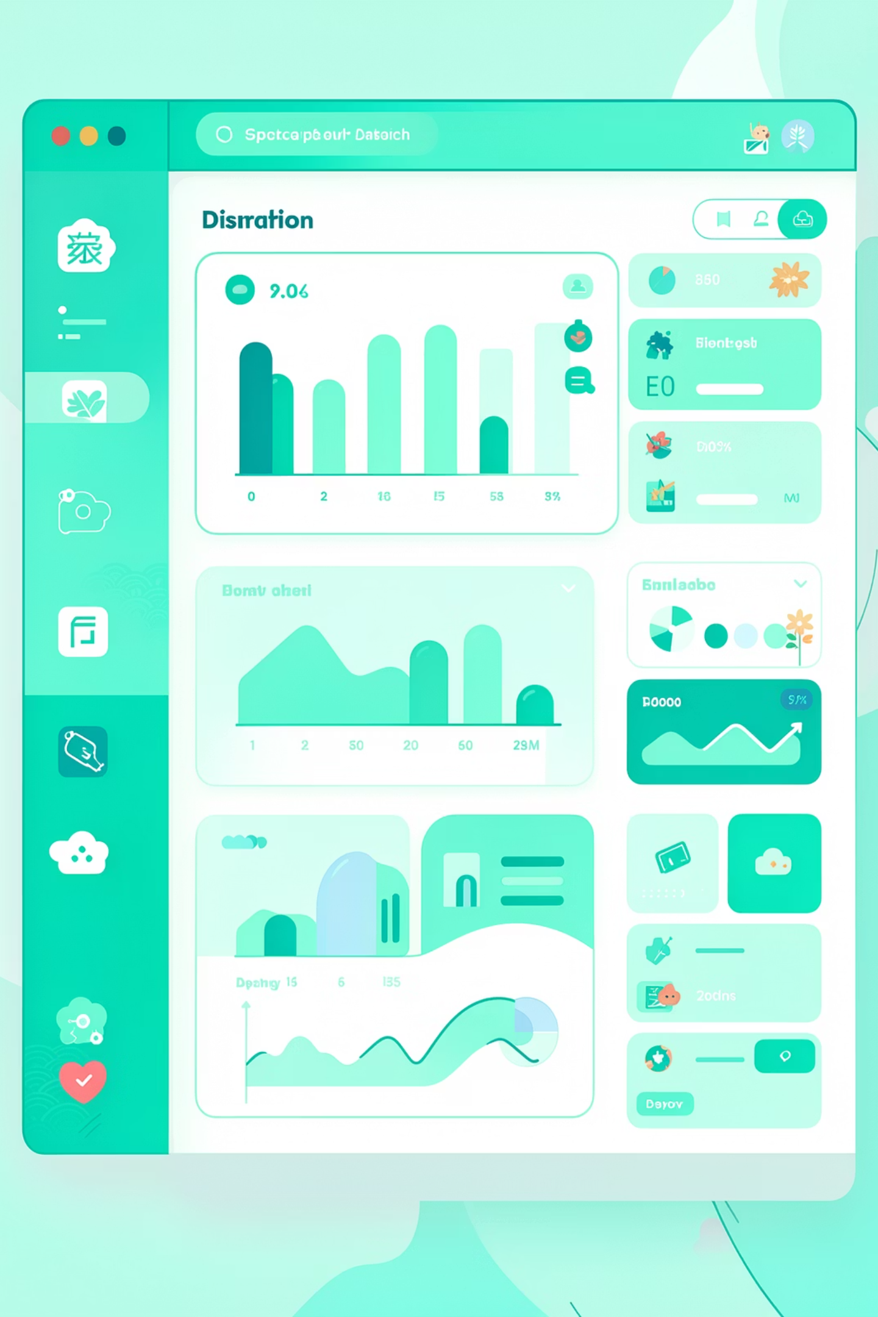
Application Features
Public User Features
Submit student details through a clean, responsive form
Real-time validation ensures data quality
Cloud-based access from any device
Private Admin Features
View all student records securely behind authentication
Data fetched directly from Azure SQL Database
Admin dashboard provides complete record overview

Slide 11
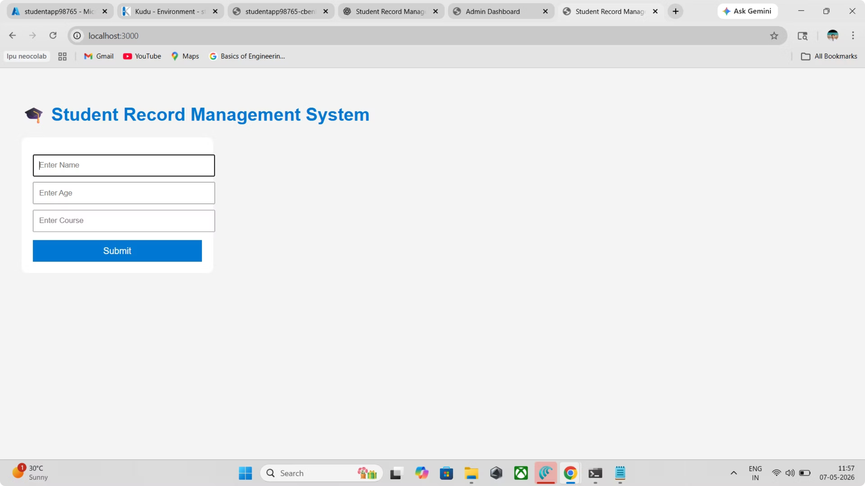
Public User Features

Slide 12
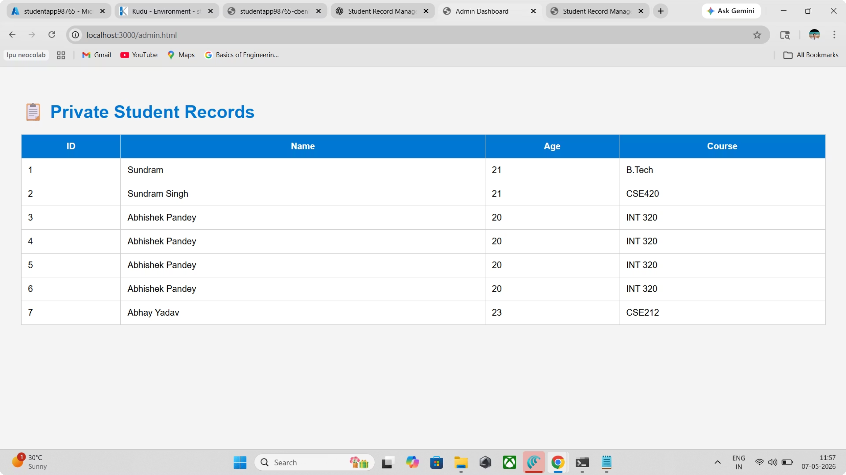
Private Admin Features

Slide 13
Deployment Process
GitHub Repository
Created version-controlled repository to manage source code and collaborate efficiently
Azure App Service
Configured App Service with Node.js runtime environment for application hosting
Database Integration
Connected Azure SQL Database to backend with secure connection strings
Firewall Rules
Configured IP address restrictions to allow only authorised access to the database
Testing & Verification
Tested complete user flow from form submission to admin dashboard display

Slide 14
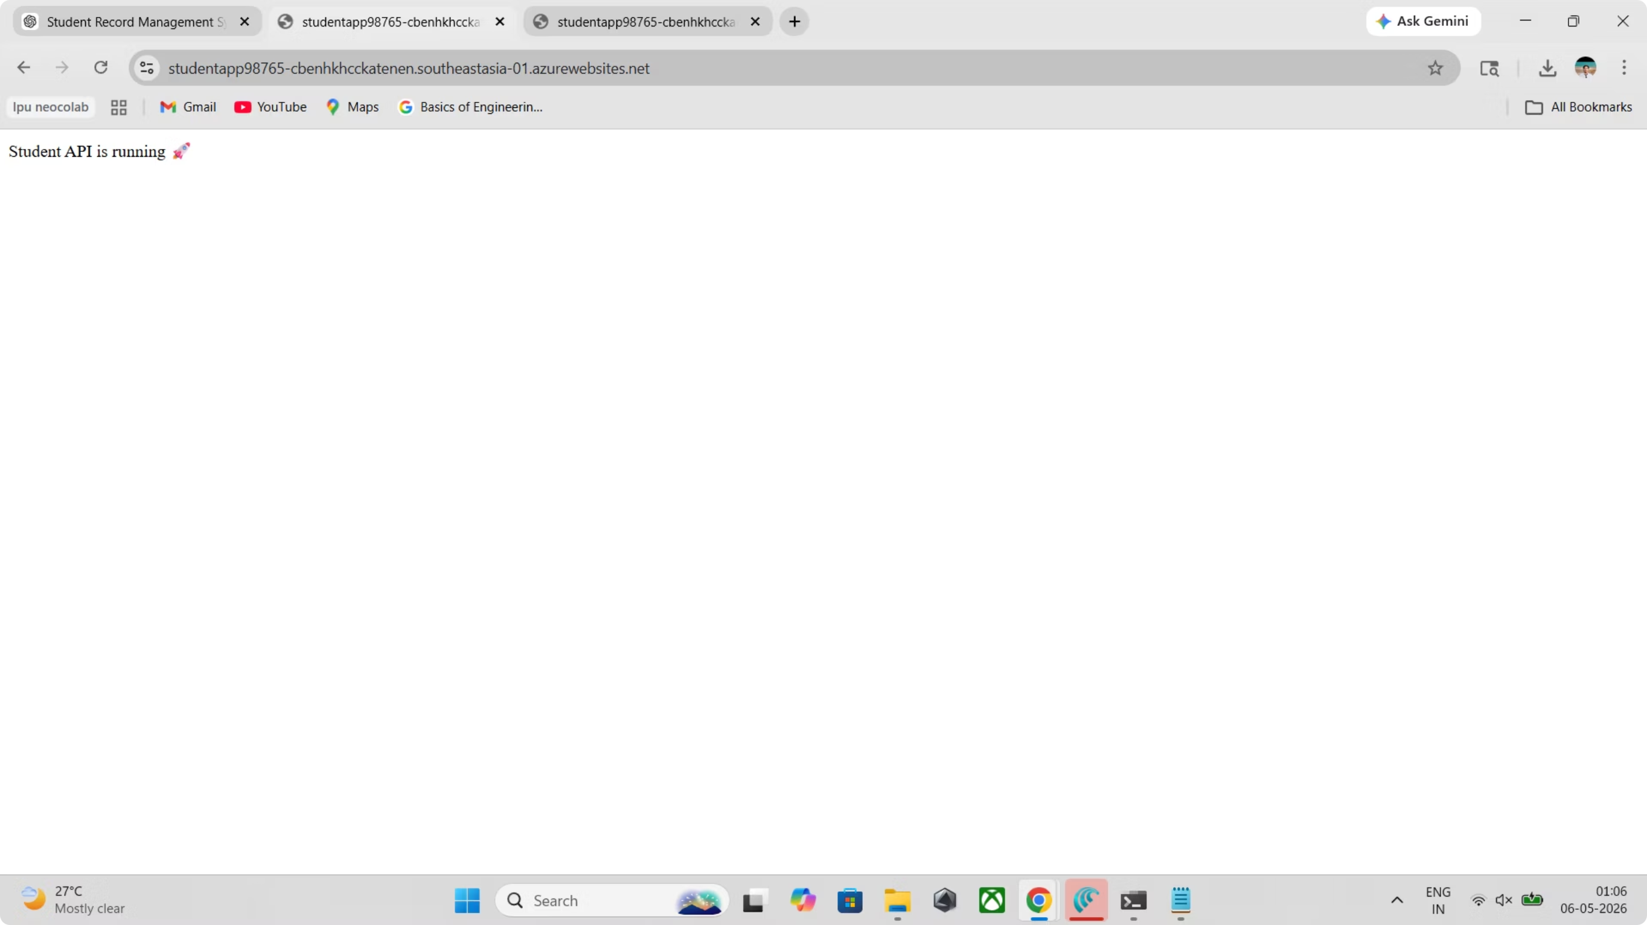

Slide 15
Challenges and Learning Outcomes
Challenges Faced
Learning Outcomes
Azure SQL Firewall Issues
IP Restrictions
Dynamic IP addresses caused intermittent access problems during development
Initial connection failures due to strict firewall policies requiring IP whitelisting
Azure App Service
Backend Integration
Mastered cloud application deployment and configuration
Learned Node.js backend integration with frontend interfaces
GitHub Conflicts
Deployment Troubleshooting
Version control merge conflicts when pushing code to remote repository
Environment configuration differences between local and Azure servers
Cloud Database
Version Control
Gained experience with cloud database management and optimisation
Developed proficiency with GitHub for collaborative development
Project Workflow
Understood real-world cloud project development lifecycle

Slide 16

Conclusion and Future Scope
Project Success
Future Enhancements
This project successfully demonstrates full-stack cloud-based development by integrating frontend, backend, and Azure SQL Database into a cohesive student management system hosted on Microsoft Azure.
User Authentication
Implement secure login system with session management
CRUD Operations
Live Applications
Add update and delete functionality for record management
Public User: Azure Web AppAdmin Dashboard: Admin Interface
Source Code: GitHub Repository
Modern Frontend
Replace vanilla JavaScript with React framework for enhanced UX
Email Notifications
Send confirmation emails upon successful registration
Thank You
Questions & Answers

